Slide 1
Digital Marketing project work
Company Name : PETER ENGLAND

Slide 2

Part 1: Brand study, Competitor Analysis & Buyer’s/Audience’s Persona
Company:PETER ENGLAND
Research Brand Identity :Study the brand’s mission , values ,vision , and unique selling propositions (UPSs)..
BRAND LOGO :

Slide 3
VISION: The brand's vision is to become the most loved apparel brand of India offering clothes and accessories of unmatched value, to help young consumers realise their full potential. MISSION: The goal of Peter England is to be its consumers'' preferred choice while being the country''s most trusted as well as the most exciting brand to be present in the retail sector VALUES: Its core values lie in its goal to be its consumers'' preferred choice. Integrity/commitment/speed/seamlessness/passion. USP: Peter England, specifically PE Jeans, is imagined and built on three basic philosophies: sustainability, fusion and fashion.

Slide 4
Analyze Brand Messaging:
“ Be Everything ”
Examine the brand's tagline:
“ Beginning good Things ”

Slide 5


COMPETITOR ANALYSIS :
Competitor 1: Gritstones : offers preeminent quality and exemplary style for trendy men and women.
https://www.gritstones.com/

Slide 6


Competitor 2 : KillerJeans : Brings innovation and superior design into their product ranges, appealing to the bold, brash, rebellious, unique, creative and sustainable audience. https://www.killerjeans.com/

Slide 7


Competitor 3 : Men's Wearhouse : promoting a happy and healthy lifestyle, enhancing a sense of community, and striving toward becoming self-actualized people. https://www.menswearhouse.com/

Slide 8
Buyer's/Audience's Persona: Clearly define the target audience for the chosen brand. Consider demographics, psychographics, behaviors , and interests.

Slide 9

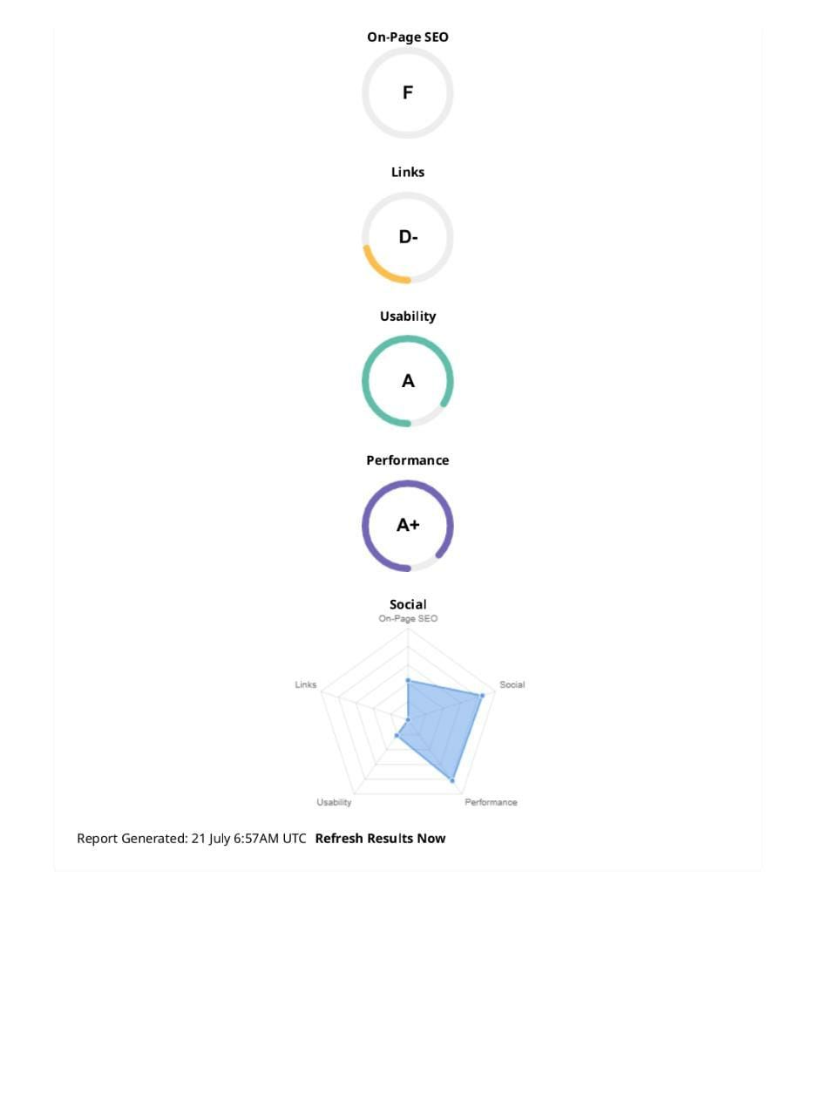
Part 2: SEO & Keyword Research
SEO Audit: Do an SEO audit of the brands website

Slide 10
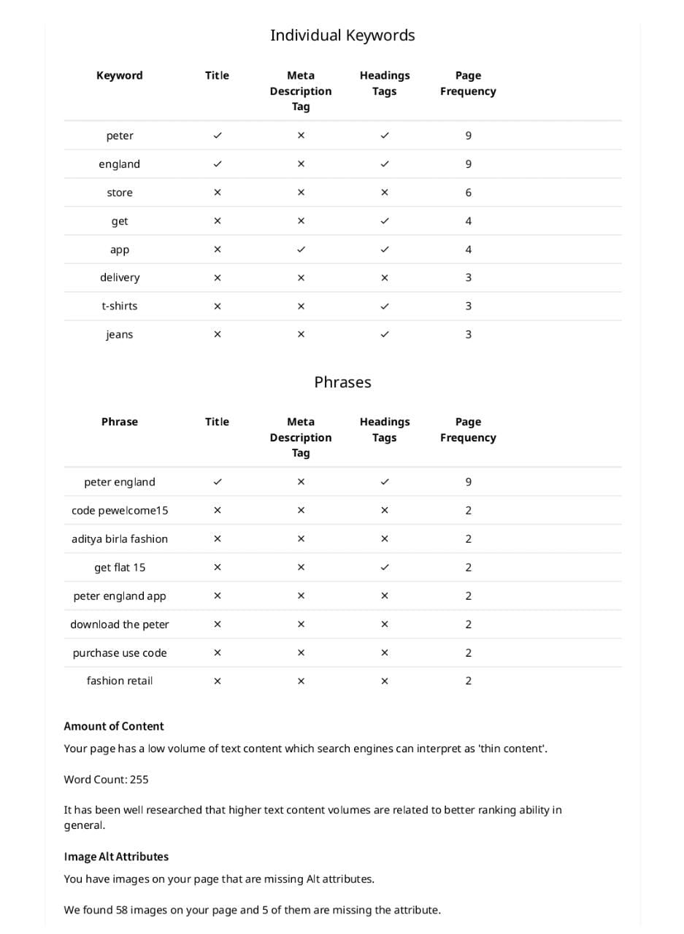
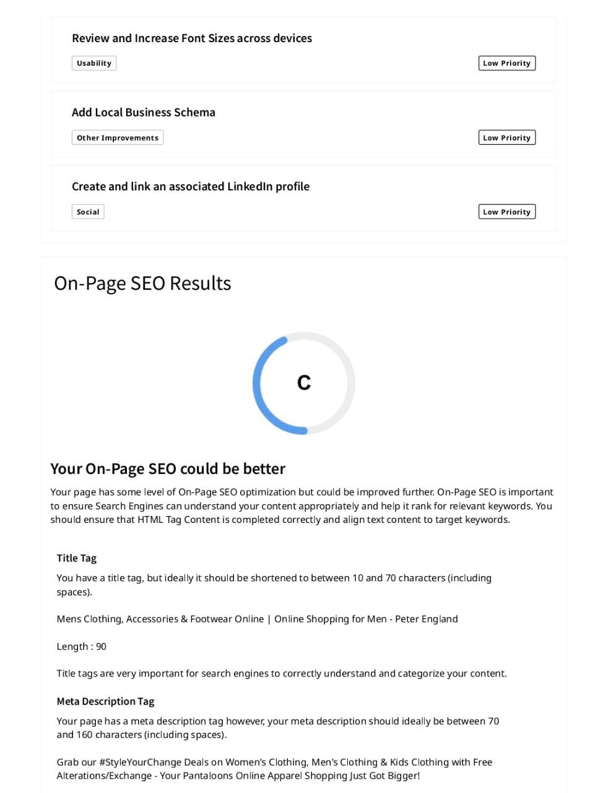

Slide 11
KEYWORD RESEARCH :
Peter England
Peter England clothing
Peter England menswear
Peter England shirts
Peter England suits
Peter England fashion
Peter England online store
Peter England India
Peter England latest collection
Peter England discounts
Peter England sale
Peter England review
Peter England fashion trends
Peter England wedding collection
Peter England seasonal collection
Peter England latest fashion trends for men
Peter England v/s Gritstones
Peter England v/s KillerJeans
Peter England v/s Men's Wearhouse

Slide 12

Peter England Polo T-Shirts | Buy Quality Men's Polo Shirts Online<meta name="description" content="Discover the latest collection of Peter England polo t-shirts for men. Shop online for high-quality polo shirts at great prices. ">(URL)https://peterengland.abfrl.in/p/men-navy-solid-polo-neck-polo-t-shirts-884436.html?source=plp(Heading)<h1> Peter England Polo T-Shirts for Men</h1>
On Page Optimization :

Slide 13
Part 3: Content Ideas and Marketing Strategies
Content Idea Generation & Strategy:
The marketing strategies of Peter England stands for product, place, price and promotion including two important factors: product innovation and pricing approaches.

Slide 14
Part 3: Content Ideas and Marketing Strategies
Product plus Brand imagery (company can limit the cost incurred in promotion hence, increasing the company's profit.)
Sponsored cask (male oriented programming schedules/revenue generation and grabbed more attention.)
Loyalty program: variety of rewards to members (including free shipping, free returns, tips for spending certain amount, etc.) are offered.
Wedding collection campaign
Product strategy includes Popular menswear campaign and seasonal campaign. Other than the pricing the company also focuses on location and distribution strategies.

Slide 15
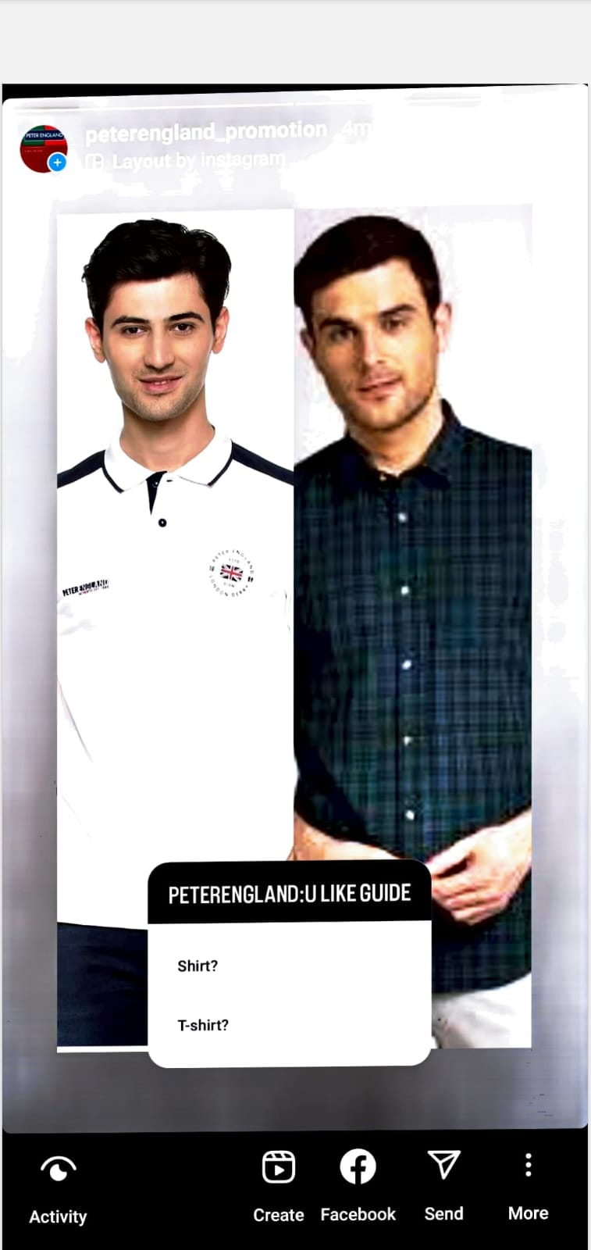

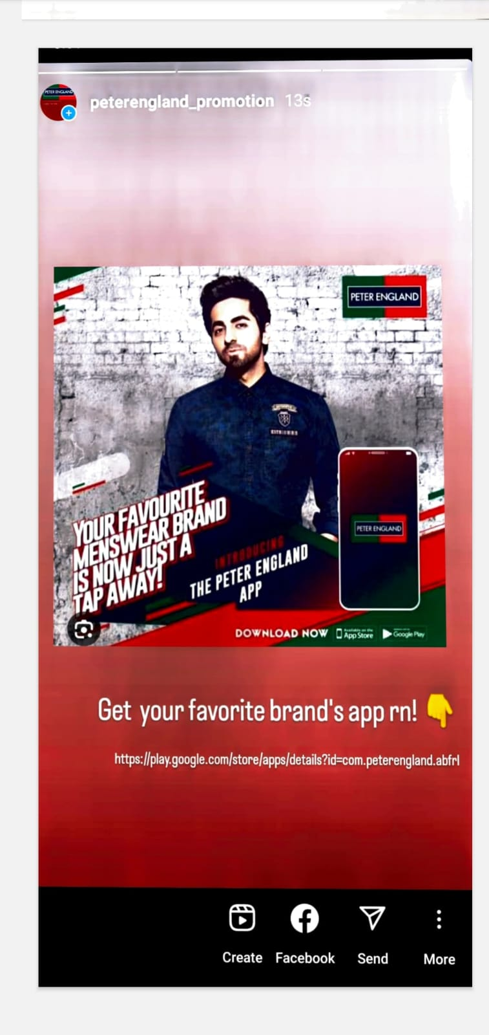
Part 4: Content Creation and Curation (Post creations, Designs/Video Editing, Ad Campaigns over Social Media and Email Ideation and Creation)
Instagram Story

Slide 16

Designs / Video Editing

Slide 17
Title: Brand Promotion of Peter England: Crafting a Timeless Identity in the Fashion World In the dynamic world of fashion and apparel, establishing a lasting brand identity is no easy feat. However, Peter England, an iconic menswear brand, has managed to not only navigate the ever-changing trends but also carve a niche for itself in the competitive market. This essay explores the successful brand promotion strategies employed by Peter England, which have contributed to its enduring popularity and prominence in the fashion industry.
Understanding the Brand: Peter England, founded in 1889 in Londonderry, Ireland, has come a long way in becoming a beloved menswear brand in India. Acquired by Aditya Birla Group in 2000, the brand has focused on designing premium-quality apparel that combines contemporary style with timeless elegance. Understanding the brand's history and core values has been essential in crafting effective promotional campaigns.

Slide 18
Target Audience : One of the key aspects of successful brand promotion is understanding the target audience. Peter England has identified its audience as fashion-conscious men aged between 25 to 45, who appreciate sophistication and value for money. By knowing its customers and their preferences, the brand has been able to tailor its marketing efforts accordingly.
Engaging Visual Identity : A visually appealing and cohesive identity is vital for brand recognition. Peter England has carefully crafted a logo and brand color palette that resonates with its target audience. The logo features a distinctive crown, symbolizing royalty and timelessness, while the color blue evokes feelings of trust and reliability. This consistent visual identity is evident across all promotional materials, reinforcing brand recognition.

Slide 19
Emphasizing Quality and Craftsmanship : A crucial element of Peter England's brand promotion is its emphasis on quality and craftsmanship. The brand prides itself on using premium fabrics, skilled tailoring, and meticulous attention to detail. Through various marketing campaigns, Peter England has successfully communicated the message that wearing their clothes means embracing a sense of class and elegance.
Celebrity Endorsements and Collaborations : Peter England has leveraged the power of celebrity endorsements to strengthen its brand image. By collaborating with popular actors, sports personalities, and influencers, the brand has been able to tap into a wider audience. These endorsements not only increase brand visibility but also associate the brand with glamour and style, aligning with its core values.

Slide 20
Creating Memorable Advertising Campaigns : In the competitive world of advertising, Peter England has managed to create memorable and impactful campaigns that resonate with its target audience. Their campaigns often focus on portraying the modern man, exuding confidence and sophistication in various situations. These ads touch on relatable themes, making the brand more approachable and aspirational at the same time.
Digital Marketing and Social Media : Recognizing the importance of the digital landscape, Peter England has invested in robust digital marketing strategies. The brand maintains an active presence on various social media platforms, engaging with its audience through captivating content, interactive posts, and contests. Such efforts not only keep the brand relevant but also allow for direct interaction with customers, building a loyal community.

Slide 21

Retail Experience and Store Design : Brand promotion extends beyond advertising; it encompasses the overall customer experience. Peter England has invested in creating inviting and aesthetically pleasing retail spaces that offer a memorable shopping experience. The store layouts and displays complement the brand's image, immersing customers in the world of Peter England.
CSR Initiatives and Sustainability In recent years, consumers have become increasingly conscious of a brand's social responsibility and sustainability efforts. Peter England has recognized this shift and incorporated corporate social responsibility (CSR) initiatives into its brand promotion. By participating in meaningful projects and promoting eco-friendly practices, the brand showcases its commitment to making a positive impact on society and the environment.

Slide 22
Geographical Expansion : Another vital aspect of brand promotion is expanding the brand's footprint. Peter England has successfully expanded its presence across various cities and towns in India. This strategic expansion has not only increased brand visibility but also allowed the brand to cater to a more extensive and diverse customer base . Peter England's journey in the fashion industry serves as an inspiring case study for effective brand promotion. By understanding its brand identity, target audience, and the changing market dynamics, the brand has managed to establish itself as a timeless and sought-after menswear brand. Through engaging visual identity, memorable advertising campaigns, celebrity endorsements, and a strong digital presence, Peter England has captured the hearts of consumers and earned their loyalty. As the brand continues to evolve, it remains committed to its core values, positioning itself as a fashion icon that stands the test of time.

Slide 23

Social Media Ad Campaigns :

Slide 24
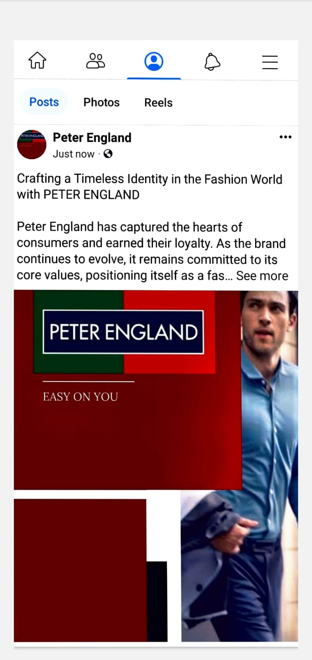
LinkedIn :

Slide 25
Facebook :

Slide 26

Email Ad Campaign - Brand Awareness:

